Slide 1
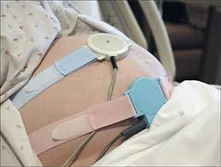
Electronic Fetal Monitoring
2008 NICHD Workshop
Definitions for
Electronic Fetal Monitoring
Dione Ganser, BSN, RNC
Walden University
NURS 6320
Notes:
Title page. Informal speaking
Welcome to class. Introduce myself and state how I came about starting this presentation. My interest because I have been working in women’s health including antepartum, intrapartum, postpartum, and newborn care for about 12 years. Recent changes and agreements in interpretation and definitions.

Slide 2
objectives
Students will be able to
-Discuss types of monitoring- external vs.
internal.
-Identify baseline FHR.
-Identify FHR variability.
-Identify FHR decelerations.
-Identify FHR accelerations.
-Understand reason for FHR declerations.
-Discuss frequency, duration, and intensity of contractions.
Notes:
Read these objectives for the class.

Slide 3
History of electronic fetal monitoring
1800s
1821 First FHR obtained by stethoscope
1893 First criteria published for diagnosing fetal distress
1900s
1968 First commercial EFM
1997 NICHD creates standard EFM definitions
2000s
2006 AWHONN & ACOG add appropriate EFM language/ definitions in educational resources
2008 Standard categories for EFM interpretation
Reference: Lyndon, A. & Ali, L.U. (2009), Sharma , D.L. (2010), Stevenson & Benitz (2003)
Notes:
History of EFM.
1818 was first time that a difference in fetal and maternal pulse was noted by Francios Major
1821 first time stethoscope used to hear FHR
1893 Von Winkel described a normal fetal heart rate at 120- 169 beats per minute
1968 First commercial development of electronic fetal monitoring
2006 AWHONN & ACOG add to the new definitions and language to educational offerings.
2008 NICHD has workshop with AWHONN and ACOG to create standard categories (I, II, &III), interpretations, and terminology.

Slide 4
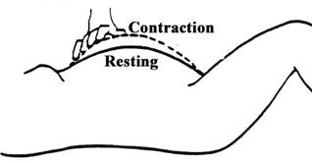
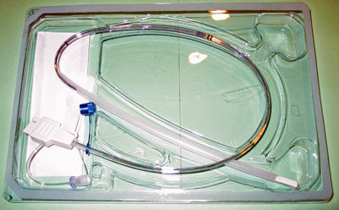
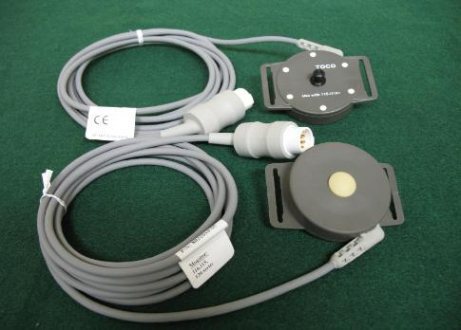
Monitoring contractions
Palpation
Internal
Intrauterine Pressure Catheter
External tocodynamometer
Notes:
Palpation- the clinician can provide a decent interpretation of contractions by placing a hand on the uterine fundus- the top of the gravid abdomen. The clinician will be able to palpate as the uterus tightens with the contraction. A practiced hand will be able to describe the contractions as mild, moderate, or strong in intensity. Mild contraction –uterus is easily intended (like the tip of the nose). Moderate contraction- uterus can slightly indent (like the chin). Strong contraction- uterus cannot be indented (like the forehead)
Tocodynamometer (a.k.a. “Toco”) - Pressure sensitive device that is placed on maternal fundus to trace contractions. The resulting tracing read from abdominal wall tenseness, measuring frequency and duration. The toco does not provide information on contraction intensity. Palpation should be added to further evaluate contractions.
Some things I have noted with the toco is the lack of consistent tracings. I often tell my patients that if they feel contractions, I would believe them before I believe the monitor because of this inconsistency. If a patient has a great deal of fatty tissue covering the uterus, the toco may not be able to pick up the uterine changes. The same can be noted if the patient is laying on their side, the contractions may not pick up. Maternal movement and position, toco positioning and placement, coughing, sneezing, vomiting, pushing… will all effect the toco making contraction tracings higher, lower, or provide spiking movments on the tracing.
Intrauterine Pressure Catheter (a.k.a. “IUPC”)- This device is used in about 20% of labors and requires rupture of membranes. The IUPC will provide a quantitative measurement of contractions’ frequency, duration, and intensity. The IUPC is a small tube that is inserted into the uterine cavity, next to the baby, during a cervical exam. Some indications for use of this more invasive measure are-
1) Need for quantitative analysis of contractions, ie. Are the contractions strong enough for adequate labor?
2) Need for amnioinfusion- fluid can flow through this tube to help alleviate some cord compression.
3) External toco is not providing a readable tracing when oxytocin is in use.

Slide 5
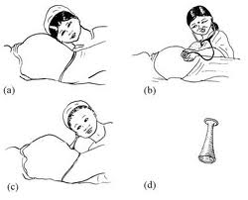
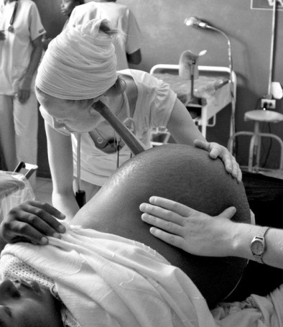
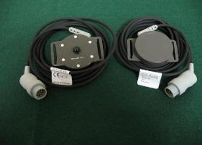
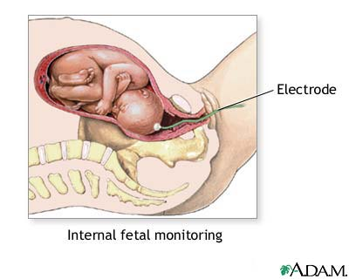
Monitoring fetal heart rate
External devices for listening to fetus
External continuous ultrasound monitors
Fetoscope
Early wooden stethescope
Internal fetal scalp electrode for continuous fetal heart rate tracing.
Doppler
Notes:
Stethescope
Fetoscope
Doppler
Ultrasound- Ultrasound discs can be placed on maternal gravid abdomen to trace fetal heart rate externally. The u/s generates sound waves that reflect back from the fetal heart movement. The computer interprets these sound waves and presents a sound and continuous tracing.
Fetal Spiral Electrode- Internal electrode placed on fetal scalp to trace fetal heart rate. This would require rupture of membranes. This also causes a small open scratch on top of the baby’s head that could lead to infection. The electronic logic provides detection of R-to-R waves in QRS to obtain the fetal heart rate.

Slide 6
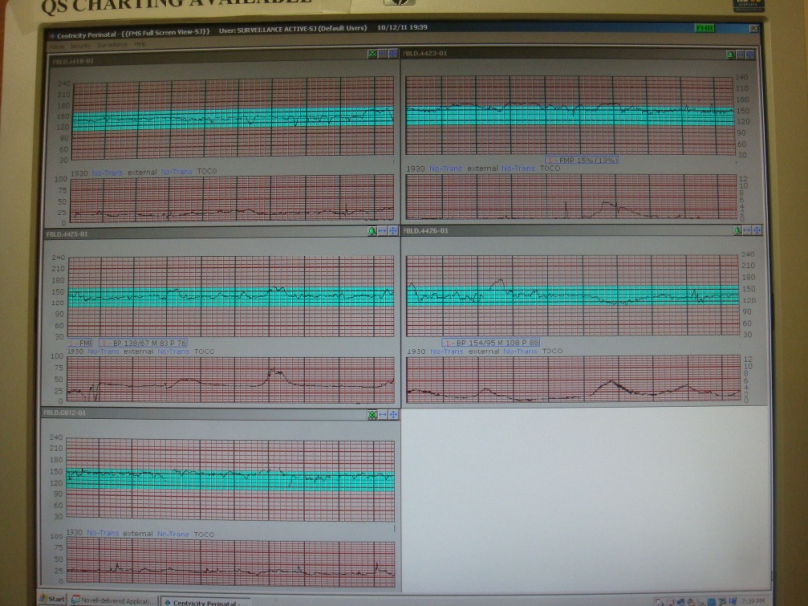
Electronic Fetal monitors
“Get me outta here!” –Love, Baby
Notes:
Electronic fetal monitors have been in use since the 1970’s. There are arguments for and against the use of EFM. There are studies that note no improvement in maternal and fetal mortality and morbidity.
“The primary objective of EFM is to provide information about fetal oxygenation and prevent fetal injury that could result from impaired fetal oxygenation during labor” (Fedorka, 2010).
Top line continuous reading of fetal heart rate
Bottom line is continuous reading of contractions

Slide 7
Contractions
Frequency of contractions are defined as the time in minutes between the start of one contraction and the start of the next.
1 minute
1 minute
1 minute
1 minute
2 minutes
Intensity
60 seconds
1 minute
1 minute
Intensity measures the strength of the contraction. IUPC is the only quantitative measurement of contractions.
Duration is measured in seconds from the start to the end of a contraction.
Notes:
Frequency of contractions- measured in minutes from the start of one contraction to the start of the next contraction. This is usually described in a range of most frequent to least frequent contractions.
Duration is a measured range in seconds from the start to the end of the contraction.
Intensity is measured by mmHg with IUPC or by palpation.

Slide 8
fhr baseline
Baseline FHR is the median rate to the nearest 5 BPM. A normal FHR baseline is between 110 and 160 BPM. Below 110 BPM is bradycardia. Above 160 is tachycardia.
150 BPM
140 BPM
Median 135
130 BPM
120 BPM
The fetal heart rate in the above graph has visually apparent variability between approximately 130 and 140. The middle ground of this variability, to the nearest 5 BPM, is 135 BPM.
Lyndon & Ali, 2009
Notes:
Baseline FHR is determined over at least a 10 minute time period in order to evaluate the mean. This 10 minute time frame will need to include at least 2 minutes of interpretable FHR data.
A baseline change occurs if the mean FHR has increased or decreased lasting for more than 10 minutes.

Slide 9
Fhr variability
Variability is the irregular amplitude fluctuations of the FHR. It is considered one of the most important predictors of adequate fetal oxygenation.
Absent variability has undetectable amplitude.
Minimal variability has FHR fluctuations between 1-5 BPM.
Moderate variability has FHR fluctuations between 6-25 BPM.
Marked variability has FHR fluctuations over 25 BPM.
NCC Monograph, 2010
Notes:
The NICHD decided on the above definitions for FHR variability. Absent, minimal, moderate, and marked. Moderate variability is the good one.

Slide 10
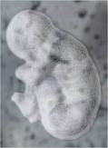
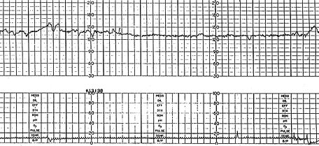
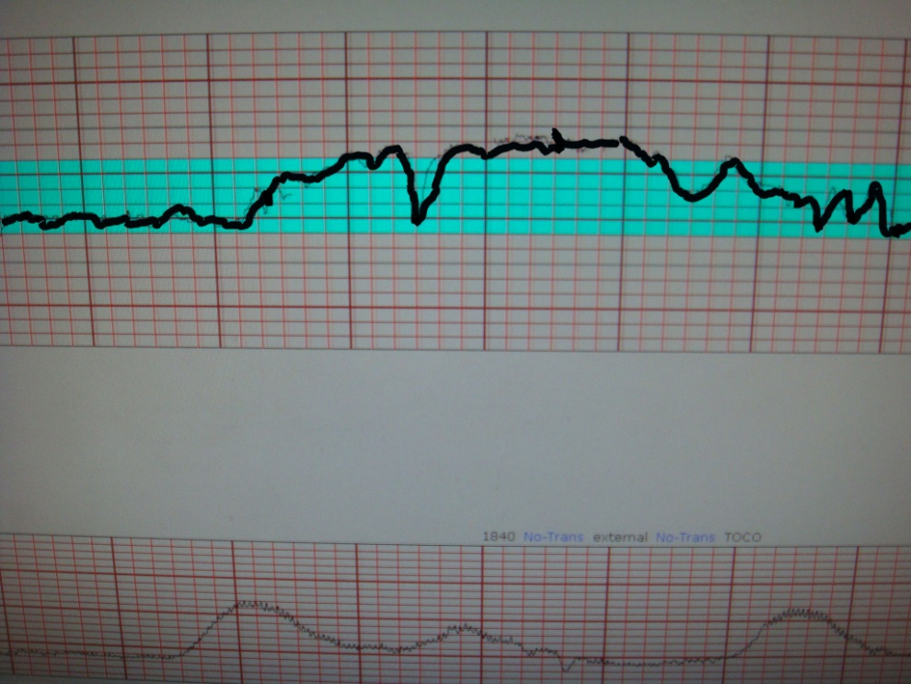
accelerations
Fetal heart rate accelerations-
Less than 32 weeks- 10 x 10
Greater than 32 weeks- 15 x 15
Acceleration
Prolonged accelerations last for over 2 minutes but less than 10 minutes.
An acceleration that last for more than 10 minutes is considered a baseline change.
Prolonged accleration
NCC Monograph
Notes:
Fetal heart rate accelerations-In pregnancies at 32 weeks and above, when the fetal heart rate increases abruptly from the baseline with the peak at least 15 BPM lasting for at least 15 seconds (but not more than 2 minutes), this is called an acceleration. In pregnancies less than 32 weeks an acceleration is described as an increase of 10 BPM lasting for 10 seconds.
Acceleration in fetal heart rate that is longer than 2 minutes but less than 10 minutes are referred to as prolonged acceleration.
If the acceleration lasts more than 10 minutes, this should be considered a baseline change.

Slide 11
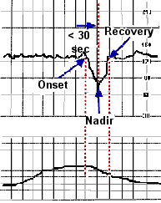
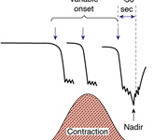
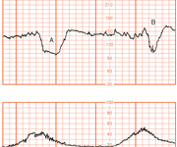
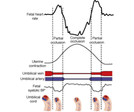
Variable deceleration
This abrupt drop in FHR indicates umbilical cord compression.
Variable decelerations are an
abrupt drop in fetal heart rate regardless of relationship to contractions.
NCC Monograph
Notes:
This deceleration decreases by 15 BPM from the baseline to the nadir lasting at least 15 seconds but less than 2 minutes. If it is over 2 minutes then it is a prolonged deceleration. If it is over 10 minutes, it is a baseline change.

Slide 12
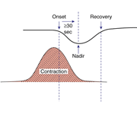
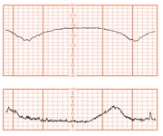
Late deceleration
The gradual change of late decelerations indicates utero-placental insufficiency.
Late decelerations usually start after the peak of the contractions. This gradual decrease from baseline to nadir is over 30 seconds or more. These decelerations only occur with contractions.
Intrauterine resuscitation measures-
-Maternal repositioning
-Fluid bolus
-Correction of maternal hypotension
-Evaluate and correct for tachysystole
-Maternal oxygen supplementation by non-rebreather mask in the presence of minimal or absent variability.
NCC Monograph
Notes:
These decelerations can be ominous but further evaluation is required.
Did the mother just get an epidural? Epidural causes hypotension which would effect the blood flow to the uterus. Correct the maternal hypotension and re-evaluate.
Is the baby post-dates or is there a known reason for a poor functioning placenta?
Was the mother in an accident or was there trauma to the gravid abdomen? Think about placenta abruption.
Are the contractions more than 5 in a 10 minute period (tachysystole)?
Intrauterine resuscitation interventions are appropriate here. The doctor should be notified of late decelerations, fetal heart rate variability, interventions provided, and fetal response to interventions.

Slide 13
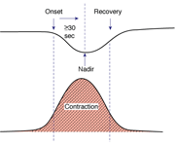
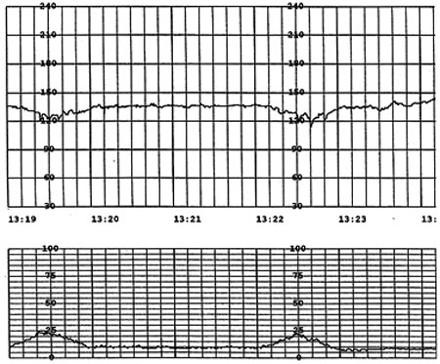
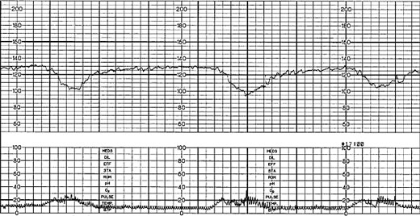
Early deceleration
Early decelerations indicate fetal head compression.
The gradual decrease of FHR mirrors the increase and decrease of contractions.
Early
Early
NCC Monograph
Notes:
Early decelerations are the least common of decelerations. It is a vagal response of fetal head compression. Think of checking labor progress to see if baby has descended and the mother is ready to push. Think of cephalopelvic disproportion in conjunction with failure of the fetal head to descend. Think of malpresentation of the fetal head.

Slide 14
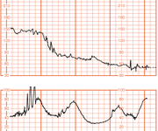
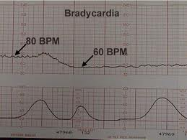
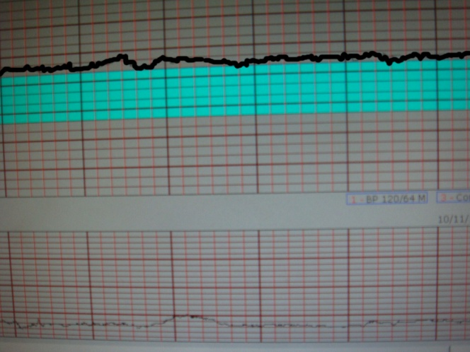
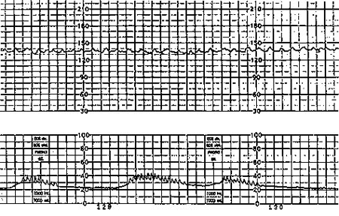
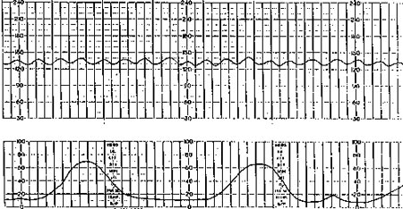
Prolonged deceleration
Bradycardia
Tachycardia
Pseudosinusoidal
Sinusoidal
Please find more helpful information at : dmganser2.weebly.com
Notes:
Prolonged deceleration is decrease in heart rate lasting over 2 minutes but less than 10 minutes. (provide interventions for intrauterine resuscitation)
Bradycardia is fetal heart rate baseline of less than 110 BPM
Tachycardia is fetal heart rate baseline of greater than 160 BPM (evaluate FHR trending and check maternal temp.)
Pseudosinusoidal pattern can be observed with the administration of narcotics or fetal thumb sucking. This undulating pattern is similar to sinusoidal but has normal variability around it and may not be as regular as true sinusoidal. No intervention is required for this pattern as it can be a normal finding.
“True” sinusoidal pattern is rare and has a smooth undulating pattern of 3-5 waves per minute for at least 20 minutes. It does not change in response to contractions or fetal movement. The likely etiology is severe anemia- think of RH isoimmunization, massive fetomaternal hemorrhage, or ruptured vasa previa. If a true sinusoidal pattern is present, the interpretation implies the fetus is near death- intrauterine resuscitation measures would not be enough. Immediate delivery of the fetus with a NICU team and available blood for transfusion is advisable.

Slide 15
references
Fedorka, P. (2010). Electronic fetal monitoring: an update. Journal of Legal Nurse
Consulting, 21(1), 15-18. Retrieved from EBSCO
http://web.ebscohost.com.ezp.waldenulibrary.org/ehost/pdfviewer/pdfviewer?si
d=e2f19c0f-c74c-41f2-b5cc-7b4eb9485962%40sessionmgr13&vid=7&hid=15
Lyndon, A. & Ali, L.U. (Eds.) (2009). Fetal Heart Monitoring: Principles and Practices
(4th ed.). Washington D.C.: Kendall Hunt.
Macones, G.A., Hankins, G.D.V., Spong, C.Y., Hauth, J., & Moore, T. (2008). The 2008
National Institute of Child Health and Human Development workshop report
on electronic fetal monitoring. Journal of Obstetrics, Gynecologic and
Neonatal Nursing, 37(5), 510-515.
Murray, S.S. & McKinney, E.S. (2010). Foundations of maternal-newborn and women’s
health nursing (5th Ed.). Maryland Heights, MO: Elsevier.
National Certification Corporation (2010). NICHD Definitions and classifications:
Application to electronic fetal monitoring interpretation. NCC Monograph,
3(1).
Sharma, D.L. (2008). Electronic fetal monitoring [Slideshow]. Retrieved from
http://www.obgyn.net/educational-tutorials/article/12571.
Stevenson, D.K. & Benitz, W.E. (2003). Fetal and neonatal brain injury: Mechanisms,
management, and the risks of practices (3rd Ed.). New York, NY: Cambridge
University Press.

